Slide 1

Ammonia Cracking
Kelly Mao

Slide 2
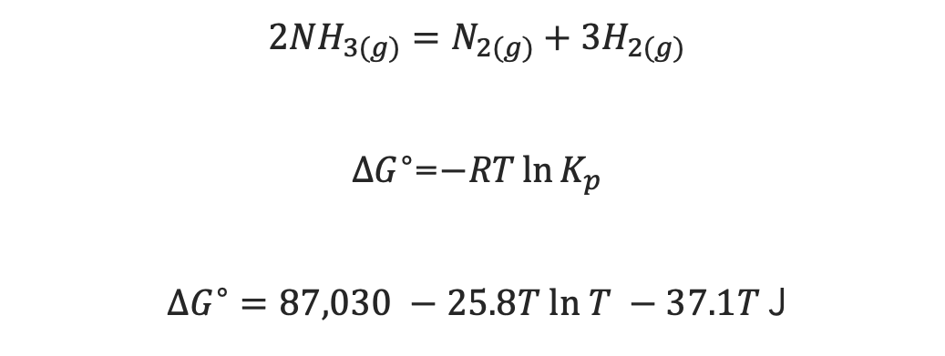
Calculations Used To Create Graphs
$${2NH}_{3(g)}=N_{2(g)}+{3H}_{2(g)}$$
=$−RT\ln{K_{p}}$
$∆G^{∘}=87,030 −25.8T ln T −37.1T$J
⇾
Reaction Equation
To obtain Kp
Standard Gibbs Free Energy Change for the reaction
⇾
⇾
This project focuses on the thermodynamic chemistry of ammonia cracking. Graphs were plotted in Python using matplotlib to demonstrate the effect of increased temperature and pressure on the mole fractions of the reactants and products of gaseous ammonia decomposition. The effects of increased temperature and increased pressure on ammonia decomposition were analyzed and conclusions were made on how to potentially increase the yield and efficiency of ammonia cracking.

Slide 3
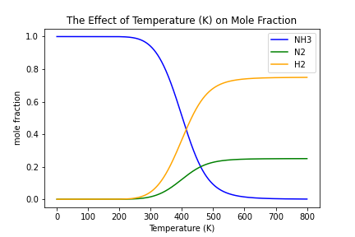
Temperature Effect On Gaseous Ammonia Decomposition
2NH3 (g) + heat = N2 (g) + 3H2 (g)
The decomposition of gaseous ammonia is an endothermic reaction
Increasing the temperature adds heat. In order to absorb this additional heat more N2 & H2 is produced.
According to LeChatelier’s principle, increasing the temperature will cause the equilibrium to shift to favor the endothermic reaction (the reaction which absorbs heat). In this case, that means the production of products (N2 & H2) is favored.
Predictably, the graph demonstrates that the mole fraction of NH3 decreases with increasing temperature, the mole fraction of N2 increases with increasing temperature, and the mole fraction of H2 increases with increasing temperature. This indicates increased presence of N2 and H2 demonstrating a shift in equilibrium to favor the production of the products.

Slide 4
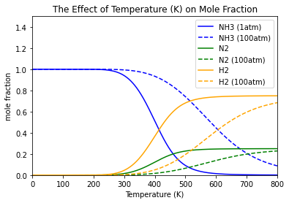
Pressure Effect On Gaseous Ammonia Decomposition
2NH3 (g) + heat = N2 (g) + 3H2 (g)
There are more moles of gas in the products (N2 & 3H2 =1+3= 4 moles) than there are moles of gas in the reactants (2NH3 = 2 moles)
To alleviate the additional pressure, more reactants are produced since there less moles of gas in the products.
According to LeChatelier’s principle, increasing the pressure will cause equilibrium to shift to favor the side of the reaction with fewer moles of gas. In this case, that means the production of reactants (NH3) is initially favored.
Predictably, the graph demonstrates that the mole fraction of NH3 decreases more slowly (flatter slope) with increasing temperature when pressure increased from 1 atm to 100 atm since the production of NH3 is initially favored.
The mole fraction of N2 and H2 increases more slowly with increased temperature (flatter slope) at higher pressure, demonstrating that equilibrium shifted to favor the production of NH3.

Slide 5
Conclusions
Increasing temperature can increase the production of nitrogen gas and hydrogen gas from ammonia
Decreasing pressure can also increase the production of nitrogen gas and hydrogen gas from ammonia
Though seemingly simple and straightforward in theory, these changes can help increase the efficiency and yield of hydrogen gas production via ammonia cracking

